Slide 1
“SPORTIFY”
Cloud Computing Project
외국인팀 - Jason, Michael, Robby, Simon

Slide 2
Table of Contents
Introduction
Roles & Responsibilities
Milestone
Project Details
Overall Architecture
Roles of Cloud Computing
Database Model
Expected challenges
Q & A Session

Slide 3
Roles and Responsibility
Michael
Team Leader & Front-end
Jason
Front-end
Robby
Back-end
Alex
Database
Notes:
Michael is our team leader, and he also responsible in making the website front-end along with Jason. Our job is to:
Develop the user interface for the website.
Ensuring the website is responsive and accessible across various devices and browsers.
Working with back-end developers to integrate the front-end with back-end.
Testing.
We don’t know much about Front-end programming, that’s why it takes 2 people to learn how to make a website.
Robby is our back-end programmer, who will make our program run as intended, he also responsible for:
Developing & maintaining the server-side.
Developing the APIs for the front-end to communicate with the back-end.
Collaborating with front-end developers to integrate the front-end with the back-end.
And Alex is our database developer, he is responsibles for:
Designing, developing, and implementing database systems for the website.
Creating stored procedures, triggers, and other database objects to support the application's functionality.
Finally, all of us are responsible for the documentation.

Slide 4

Introduction
This is how I look, pretty cool right?
What am I? I am a sports matching site
In short, I connect people to
play sports together!
So, if you need more people to play
with, I got you ;)
Notes:
There are lots of matching apps or sites nowadays, such as, tinder, bumble, etc. However, our project is I would say is quite unique. Its a sports matching site. In short, we connect people to play sports together.

Slide 5
Motivation

Slide 6


Convenient
We can make it easier for people to find others who are interested in playing a particular sport at a specific date and time.
Only within the touch of your fingers, say goodbye to playing alone.

Slide 7

Accessibility
To make sports more accessible to a wider range of people. By matching players with others who have similar interests and skill levels, the site can help people feel more comfortable and confident participating in sports.
Young or old, good or bad, they are all welcomed.

Slide 8

Community Building
By facilitating connections between players, the site can help foster friendships, encourage teamwork, and create a shared sense of passion for the sport.

Slide 9

Health and Wellness
By making it easier for people to find others to play sports with, the app can encourage people to be more active and lead a healthier lifestyle.

Slide 10
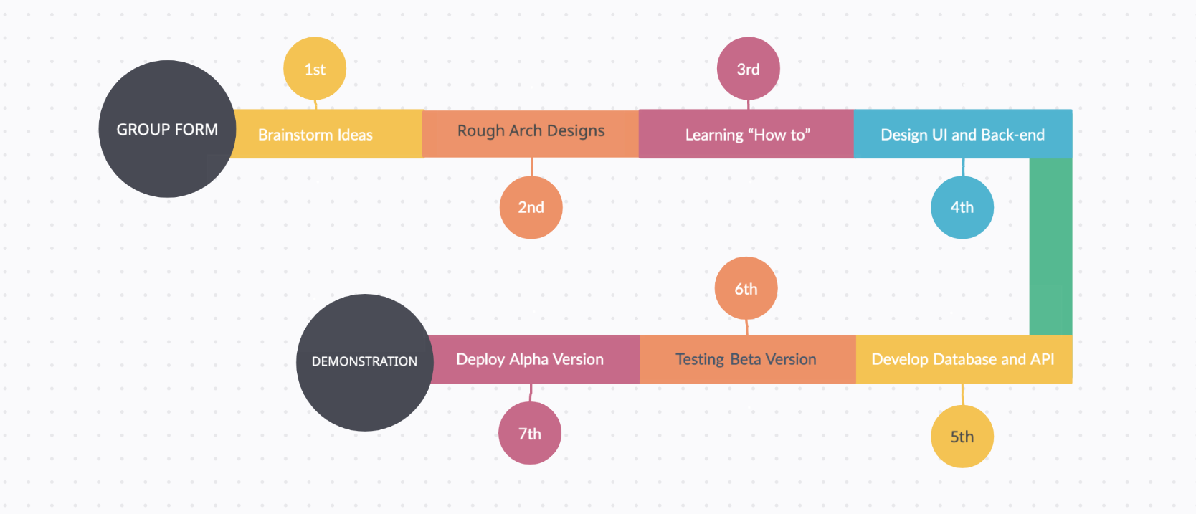
Milestone and strategy

Slide 11
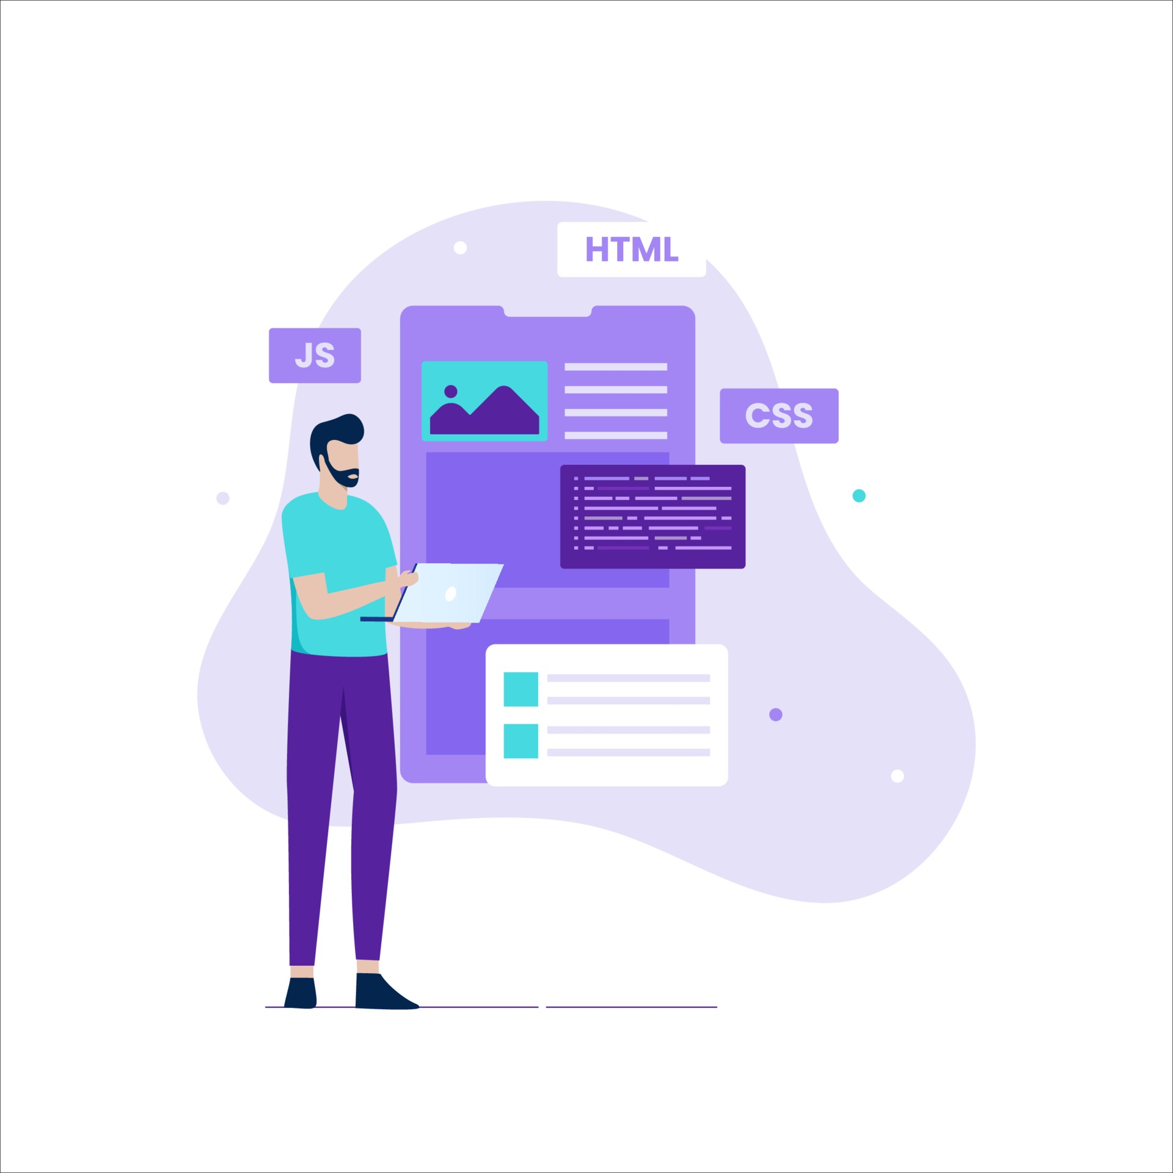


Project Details - Overall Architecture
1. USER INTERFACE
2. FRONT-END
3. BACK-END
Notes:
User Interface (UI): The UI is the part of the app that users interact with. It includes screens, buttons, forms, and other visual elements that allow users to view information and interact with the app's features.
Front-end: The front-end of the app refers to the client-side code that runs in the user's web browser or mobile device. It is responsible for rendering the UI and handling user interactions.
Back-end: The back-end of the app refers to the server-side code that runs on the app's web server. It is responsible for managing user accounts, storing and retrieving data from the app's database, and other functionality.
Database: The database is a central repository for storing user data and other app data, such as user profiles, match histories, and preferences.
API: The API allows the front-end to make requests to the back-end for data and functionality, and enables the back-end to respond to those requests.
Cloud Deployment: After all have been done, we finally deploy our back-end program to the cloud using containers, and then configure the front-end program to communicate with the deployed back-end program by update the API’s endpoint.

Slide 12
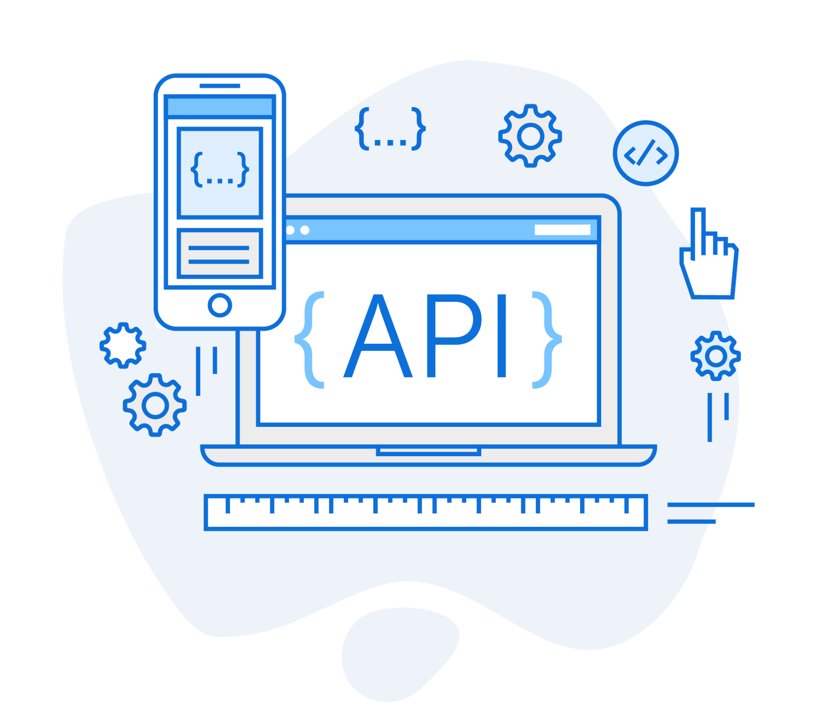


Project Details - Overall Architecture
4. DATABASE
5. API
6. CLOUD DEPLOYMENT
Notes:
User Interface (UI): The UI is the part of the app that users interact with. It includes screens, buttons, forms, and other visual elements that allow users to view information and interact with the app's features.
Front-end: The front-end of the app refers to the client-side code that runs in the user's web browser or mobile device. It is responsible for rendering the UI and handling user interactions.
Back-end: The back-end of the app refers to the server-side code that runs on the app's web server. It is responsible for managing user accounts, storing and retrieving data from the app's database, and other functionality.
Database: The database is a central repository for storing user data and other app data, such as user profiles, match histories, and preferences.
API: The API allows the front-end to make requests to the back-end for data and functionality, and enables the back-end to respond to those requests.
Cloud Deployment: After all have been done, we finally deploy our back-end program to the cloud using containers, and then configure the front-end program to communicate with the deployed back-end program by update the API’s endpoint.

Slide 13
Project Details - Roles of Cloud Computing
Server Hosting
Database Storage
User Authentication & Authorization
Data Analytics
Integration with Third-party Services
Scalability
Notes:
cloud services can play a critical role in our team matching web application project, providing a range of benefits such as scalability, flexibility, security, and cost-effectiveness.
Hosting: we use cloud computing services to host our web application, eliminating the need to set up and maintain our own servers. This can help reduce costs and provide greater scalability, reliability, and availability.
Database storage: our team web-application require a database to store user profiles, preferences, and other related information. Cloud services provide database hosting options that offer scalability, high availability, and disaster recovery features.
User authentication and authorization: Cloud services can provide secure authentication and authorization services that can help us authenticate and authorize users to access the application.
Data analytics: Cloud services offer powerful data analytics tools that can help us gain insights into user behavior and preferences and other data that help us in optimizing our matching algorithms and improve the overall user experience.
Integration with third-party services: Cloud services provide APIs that enable easy integration with third-party services such as social media platforms, messaging services, and other applications that can help enhance the functionality of our team matching application.
Scalability: As the number of users grows, the application may require additional computing and storage resources. Cloud services offer auto-scaling features that can automatically adjust the resources allocated to our application based on demand, ensuring that the application remains responsive and available even during periods of high traffic.

Slide 14
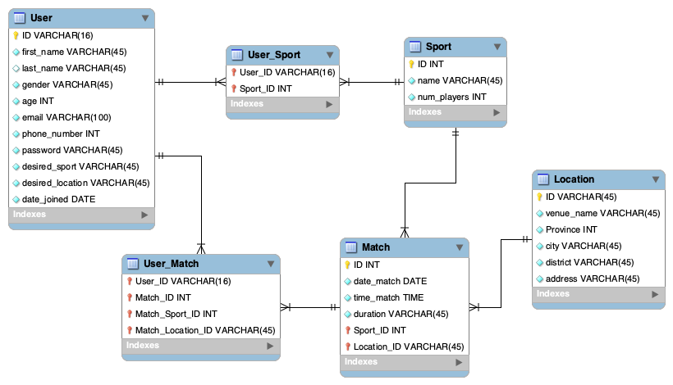
Database Model
Notes:
Our database will consist of 4 entities, which are the user, sport, match, and location entity.
User entity: This entity will represent the users who will participate in the matches. The primary key is the user ID.
Sport entity: This entity will represent the type of sport that will be played in the matches. The primary key is the sport ID.
Location entity: This entity will represent the locations where the matches will take place. The primary key is the location ID.
Match entity: This entity will represent the matches that will be played. The primary key is the match ID.
Here are the relations between the four entities which are:
User-Sport relationship: A user can participate in multiple sports, and a sport can have multiple users. In this relationship, we create a many-to-many relationship between the User and Sport entities. To do this, we create a separate table, namely "User_Sport," that contains two foreign keys, one pointing to the User table and the other pointing to the Sport table.
Match-Sport relationship: A match will be played for a particular sport, and a sport can have multiple matches. In this relationship, we create a many-to-one relationship between the Match and Sport entities. We add a foreign key column to the Match table that points to the Sport table.
Match-Location relationship: A match will take place at a particular location, and a location can have multiple matches. In this relationship, we create a many-to-one relationship between the Match and Location entities. We add a foreign key column to the Match table that points to the Location table.
User-Match relationship: A user can participate in multiple matches, and a match can have multiple users. In this relationship, we create a many-to-many relationship between the User and Match entities, in which we do this by creating a separate table, namely "User_Match," that contains two foreign keys, one pointing to the User table and the other pointing to the Match table.
By setting up these relationships, we can efficiently query the data from the database and retrieve the required information.

Slide 15
Project Details - Expected Challenges
Make a simple website.
Integrate front-end – back-end, back-end – database, and the whole program to the google cloud.
Deploy back-end program using containerization platform (Docker or Google Kubernetes Engine).
Configure front-end program to communicate with back-end program on google cloud.
Adding more features to the program, such as: - available for other different sports. - can give statistics for each user post-game. - improve the website, such as style and motion. - find a more accurate location to play, centered midway between each player's home location. - adding booking systems at the location specified after match queue compromised.
Data management.
API integration.
Actually finishing the project before the deadline :).
Notes:
Data management: The app will likely need to store and manage large amounts of data, including user profiles, match histories, and preferences. This requires robust database and data management capabilities that are scalable, secure, and efficient.

Slide 16
THANK YOU
&
ANY QUESTIONS?

